Slide 1
Neural Network (Perceptrons)

Slide 2
Classification dataset
Hours Study | Pass
2 | No
3 | No
4 | Yes
5 | No
6 | Yes
7 | Yes
8 | Yes
9 | Yes
10 | ?
Hours Study | Pass
2 | 0
3 | 0
4 | 1
5 | 0
6 | 1
7 | 1
8 | 1
9 | 1
10 | ?
Here, let’s say we are trying to predict whether a student is going to pass based on hours study
Hours study, in this case is the feature and Pass, is a label
Pass is a categorical variable consisting of two values {Yes, No}
Such categorical variable outcome prediction is referred to as classification problem
It is a task of supervised learning

Slide 3
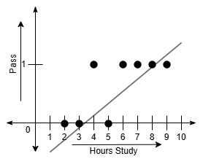
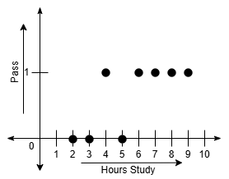
Hours Study | Pass
2 | No
3 | No
4 | Yes
5 | No
6 | Yes
7 | Yes
8 | Yes
9 | Yes
10 | ?
Hours Study | Pass
2 | 0
3 | 0
4 | 1
5 | 0
6 | 1
7 | 1
8 | 1
9 | 1
10 | ?
Let’s try to plot the dataset
Linear models can be problematic to fit such data

Slide 4
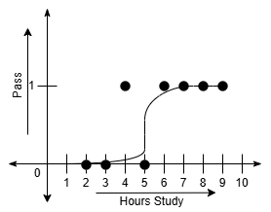
Thus, we convert the linear hypothesis to a non-linear one to fit the data
One such non-linear activation function here used is Sigmoid
Such an activation function converts a linear hypothesis into non-linear one
Such nonlinear classification is known as logistic regression
There are other activation functions available (ReLU, Tanh)

Slide 5
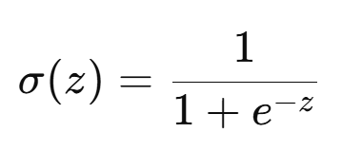
Sigmoid function
If we are trying to fit a linear equation z = w.x+b to a non-linear pattern, we convert it to a nonlinear equation instead
The conversion is done through non-linear activation functions
One such function is the sigmoid function.
Where, z = w.x+b [The linear function that we are trying to convert]
w = weight [Learnable parameter]
b = bias [Learnable parameter]
x = feature value [For multiple features, it’s a matrix multiplied with a weight matrix]

Slide 6
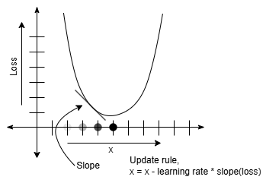
Let’s assume,
Hours Study = x
Pass = y
We’ll have to figure out z = w.x+b, and pass it through the nonlinear function
The challenge is to find appropriate values for w and b, which we can do through gradient descent
For gradient descent, we calculate the derivative of the loss function, and subtract the derivative from the respective parameter to update it

Slide 7
Loss function
Logistic regression uses the following loss function:
loss = -y.log(a) - (1-y).log(1-a)
Where,
y = Ground truth
a = Predicted value
Intuition behind the loss function:
If y = 1 and a = 0.000005 [Extreme case of misclassification]
loss = -1.log0 - (1-1).log(1-0) = 5.301 [High loss value]
If y = 1 and a = 1 [Best case of correct classification]
loss = -1.log1 - (1-1).log(1-1) = 0 [Low loss value]
If y = 0 and a = .000095 [Extreme case of misclassification]
loss = -0.log1 - (1-0).log(1-1) = 4.022 [High loss value]
If y = 0 and a = 0 [Best case of correct classification]
loss = -0.log0 - (1-0).log(1-0) = 0 [Low loss value]

Slide 8
Steps of logistic regression
Randomly initialize the w and b for z=w.x+b
Calculate the z for the initial w and b
Calculate the loss
Apply gradient descent to update the w and b
Repeat the process until convergence

Slide 9
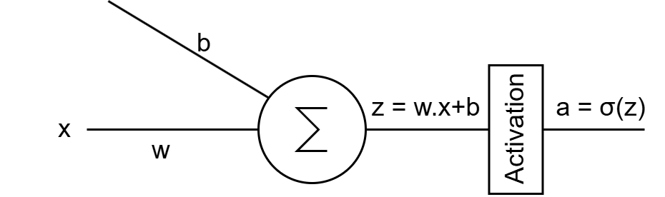
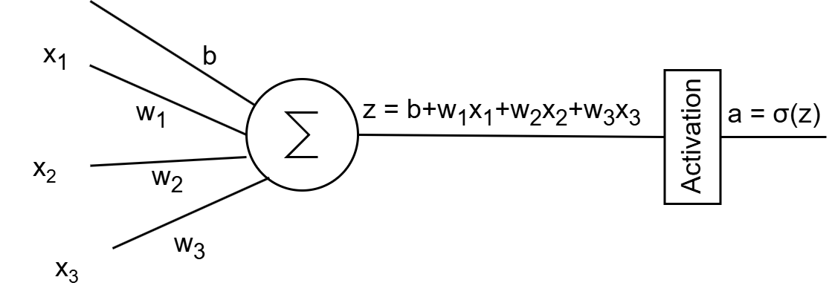
Logistic regression to neural networks
Logistic regression can be expressed as a single neuron neural network
Where, for a single feature and a single neuron, the network looks like:
For multiple features on a single neuron, the architecture may look like:
Single layer neural networks are referred to as perceptrons

Slide 10
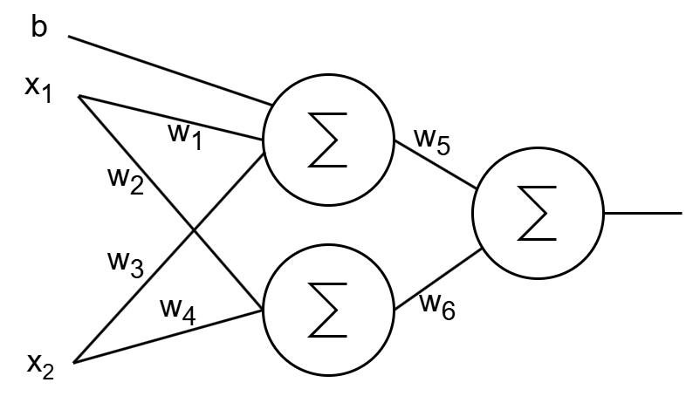
Logistic regression to neural networks
A network can involve multiple neurons
And it can become fairly large and complex

Slide 11
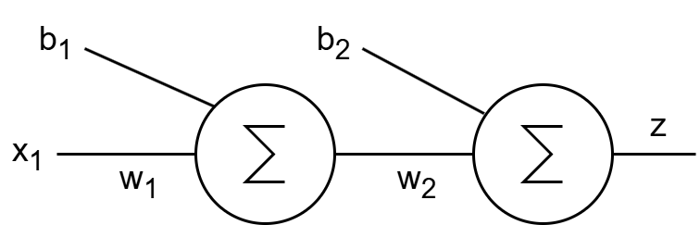
Neural networks
A method of processing based on multiple connected processing unit
Each neuron is a linear function, followed by a nonlinear activation function
The connectivity of the neurons build up a nested function
Can learn complex patterns
In the neural network above: z = σ(σ(x₁.w₁+b₁).w₂+b₂)
In a larger network, the function becomes much more nested and complex with many learnable parameters, giving it the ability to learn complex patterns
The learning process stays the same. After initialization, the weights {w₁, w₂, w₃,…, w_{n}} and biases {b₁, b₂, b₃,..., b_{m}} have to be updated through gradient descent

Slide 12
Neural networks
The types of neural networks that we talked about until now is known as feedforward neural networks
There are also other forms of neural networks
Some of the basic types are:
Feedforward Neural Networks
Convolutional Neural Networks
Recurrent Neural Networks
Generative Adversarial Networks
Transformers
… and Many More!
For this lecture, we are going to talk about the feedforward networks only

Slide 13
Training a Neural Network
Collect dataset
Define the architecture of the Neural Network model that is to be trained on the data
Initialize all the weights and biases
Calculate output based on the initialized weights and bias, which is called forward propagation
Calculate loss using an appropriate loss function
Update the last layer weights and bias using the gradient of the loss
Propagate the gradient to update the backwards layers, known as backpropagation
Run in a loop until convergence

Slide 14

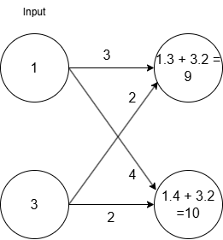
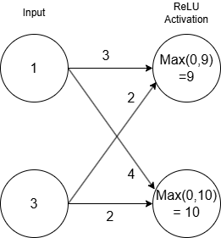
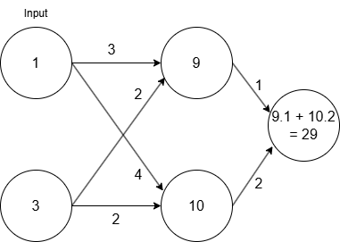
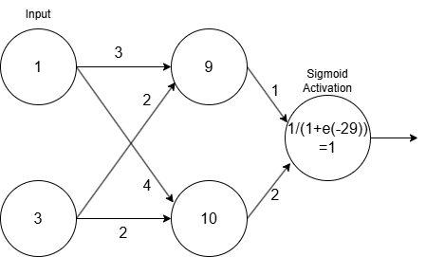
Forward Propagation

Slide 15
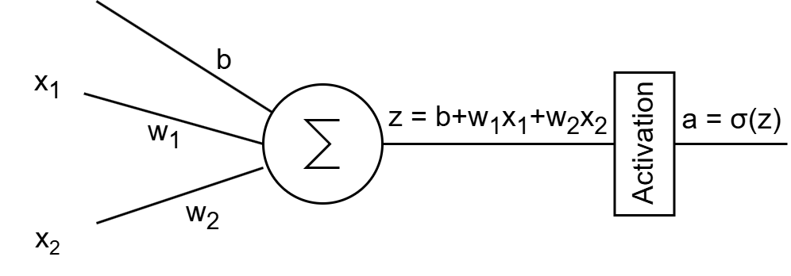
Back to the Single Neuron Perceptron
Here, there are two input feature values (x₁, x₂), output is (a)
The loss function discussed in the logistic regression can be used here, referred to as sigmoid loss function

Slide 16
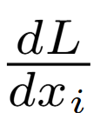
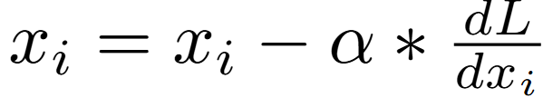
Update process
Calculate output a for all the data points in the dataset
Calculate loss for n number of data points using:
To update x_{ᵢ}, Calculate derivative of loss using
Update x_{ᵢ} using
Where, α is the learning rate
Update all the weights and biases in the network

Slide 17
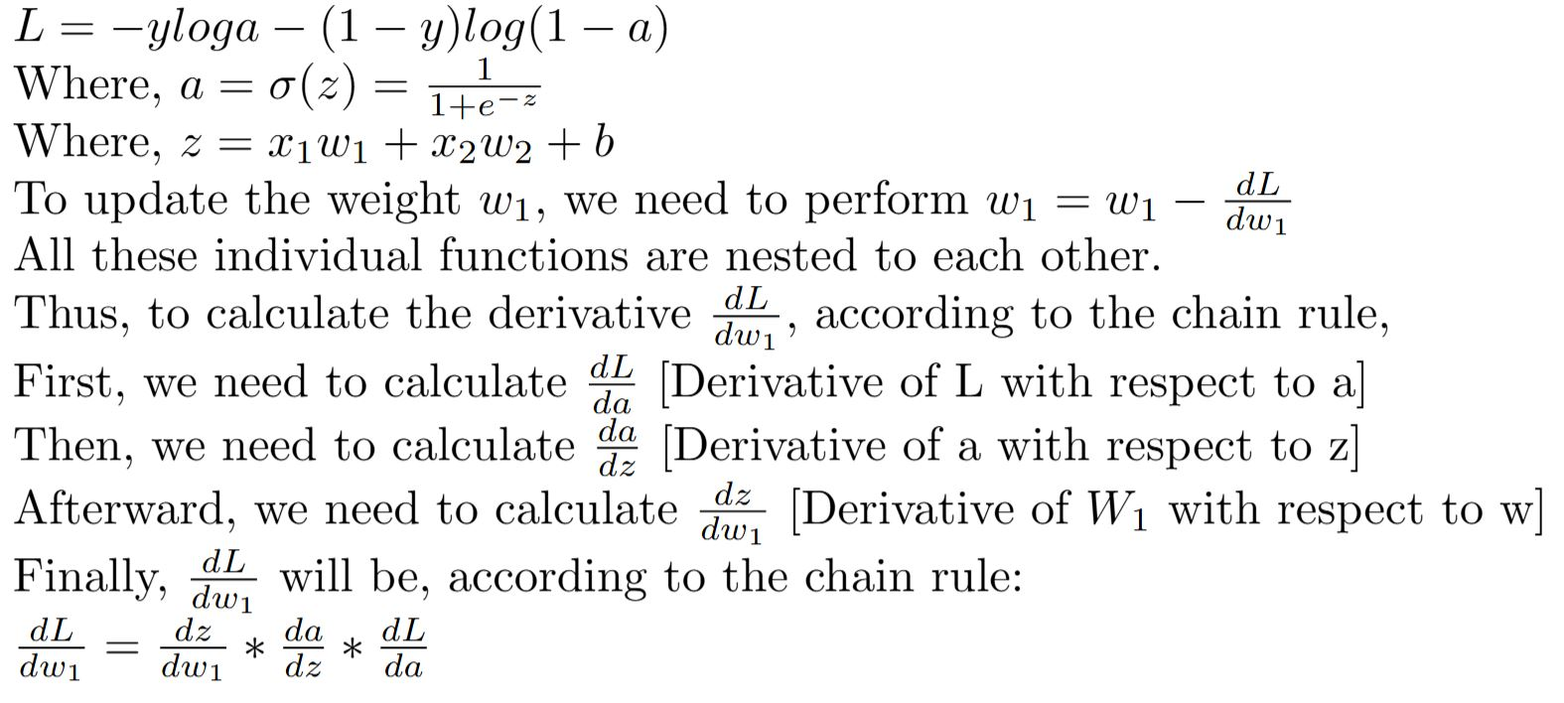
Gradient Calculation

Slide 18
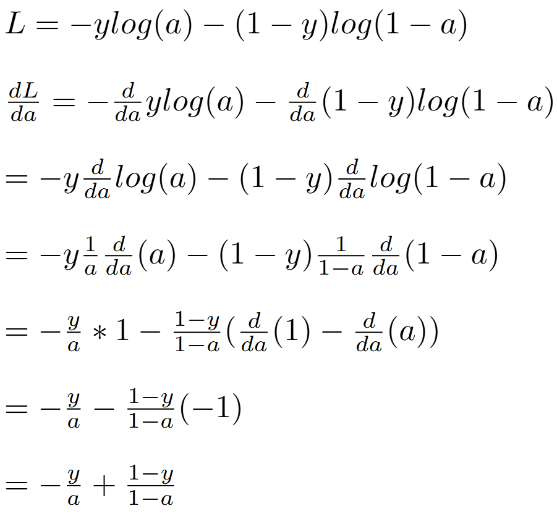
Let’s calculate the derivatives

Slide 19
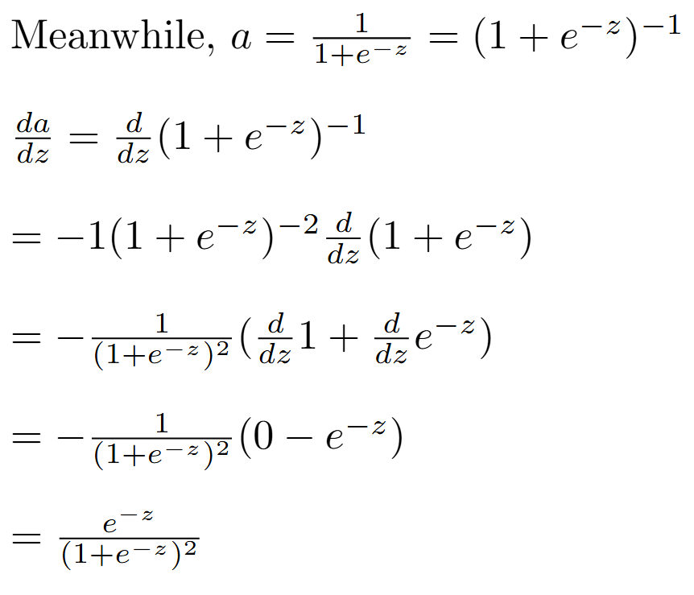
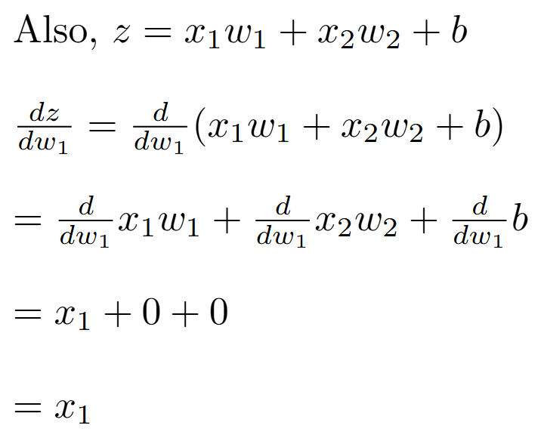
Let’s calculate the derivatives

Slide 20
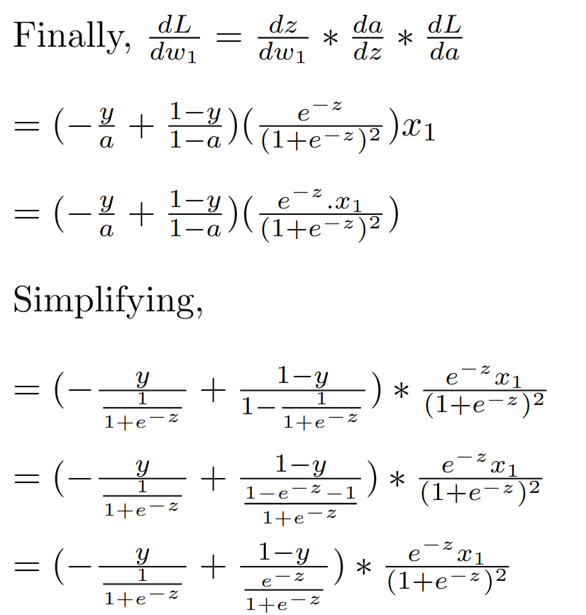
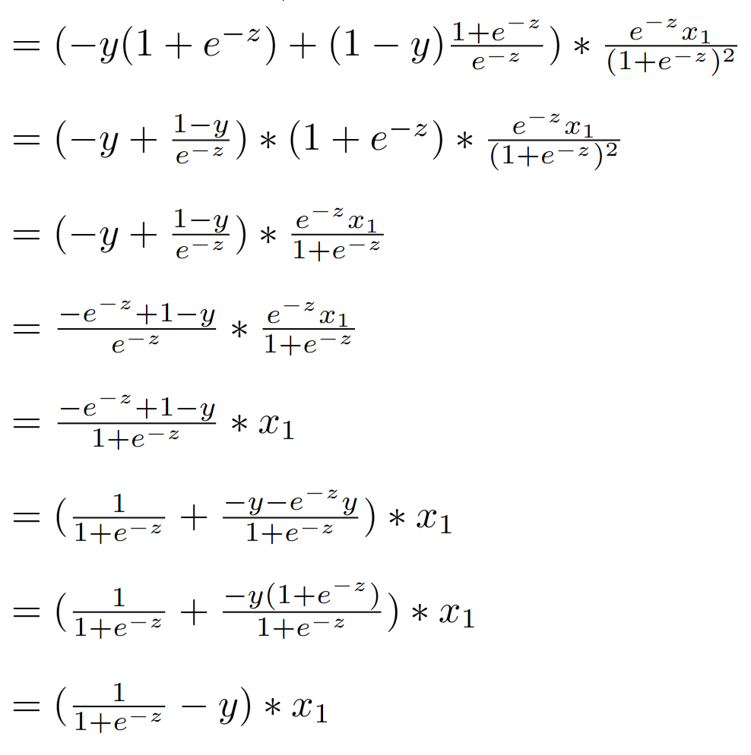
Let’s calculate the derivatives

Slide 21


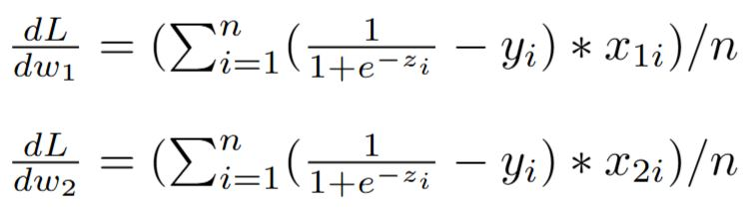

So, for a single neuron perceptron,
The gradient with respect to w₁ is,
The gradient with respect to w₂ would be,
This is for a single data point. For n number of samples, all the gradients have to be summed up and then averaged

Slide 22
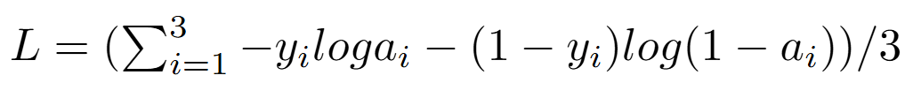
Some Basic Simulations
Let’s have a toy dataset
X | Y
.1 | 0
.2 | 0
.3 | 1
.4 | ?
We are trying to fit it with the following perceptron
w and b are the unknowns, which have to be figured out
For three data points, the loss function is:

Slide 23
Initializing,
W = .7
b = .1
Thus, z = .7x+.1
As the weights are randomly initialized, it should not fit our data points well, resulting in large error.
Let’s calculate the error through the loss function
(Please note that we should use the normalized version of all the values for faster and appropriate convergence. For simplicity, we are ignoring that step here.)

Slide 24
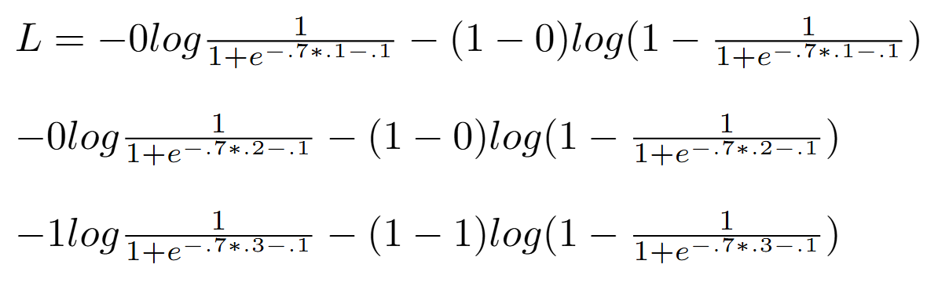
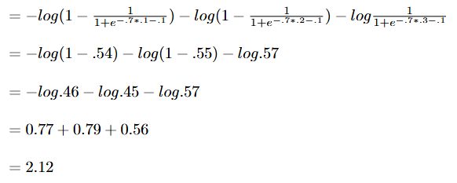
Now, calculating the sum of loss for the three points in the dataset:
[For the first data point]
[For the second data point]
[For the third data point]
Average loss value across the three data points is 2.12/3 = 0.71

Slide 25
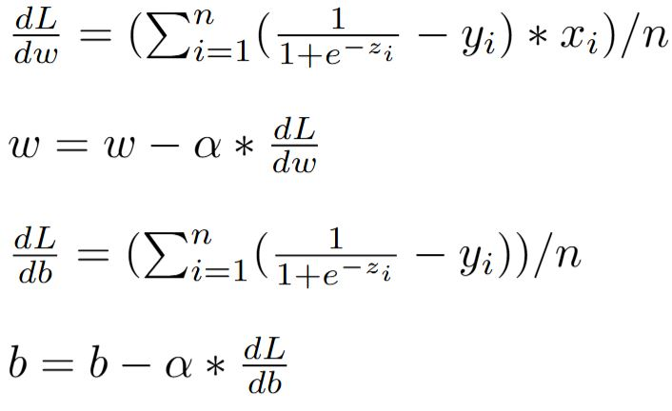
Let’s try to reduce the loss value
We’ll have to update both w and b using:
Where, α is the learning rate

Slide 26
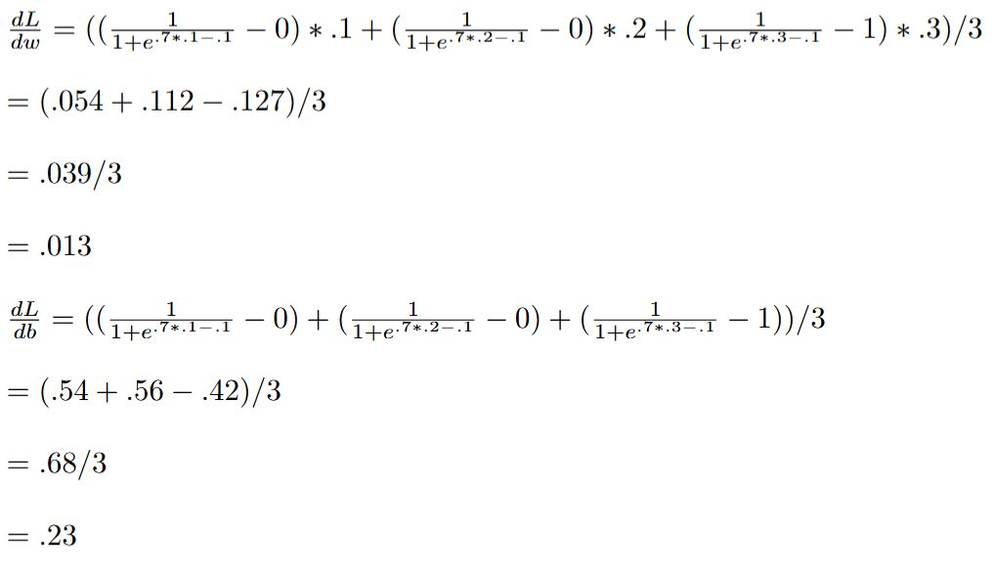
Thus, if α=1, the updated w and b are:
w = .7 - 1 * .013 = 0.687
B = .1 - 1 * .23 = -0.13

Slide 27
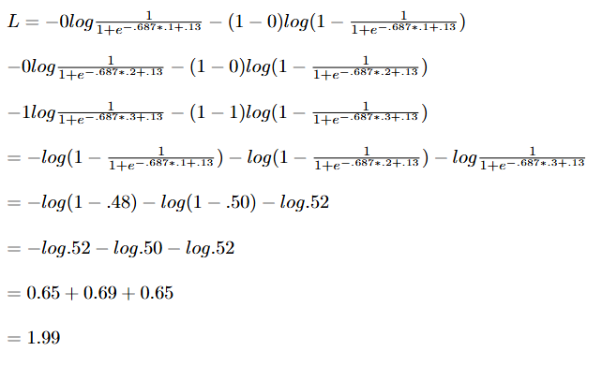
Recalculating the sum of loss:
Average = 1.99 / 3 = 0.66
Slightly better than before!
We need to run this many times in a loop to get further improvements. (Depending on the nature of data, good enough convergence might not be possible.)

Slide 28
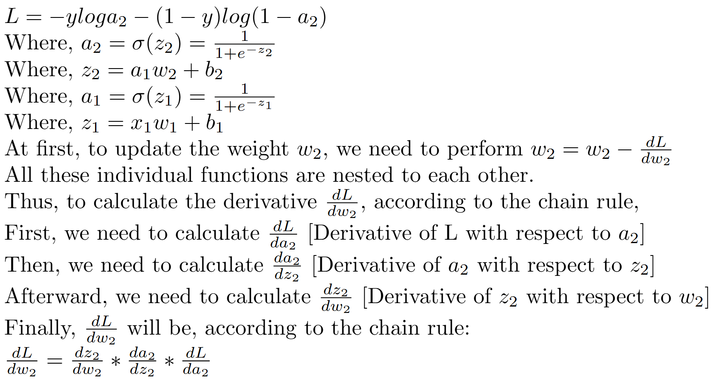
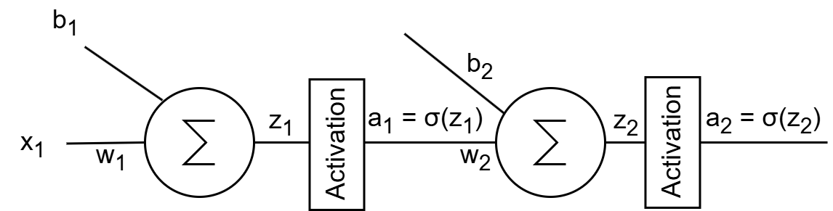
But what about a larger network?

Slide 29
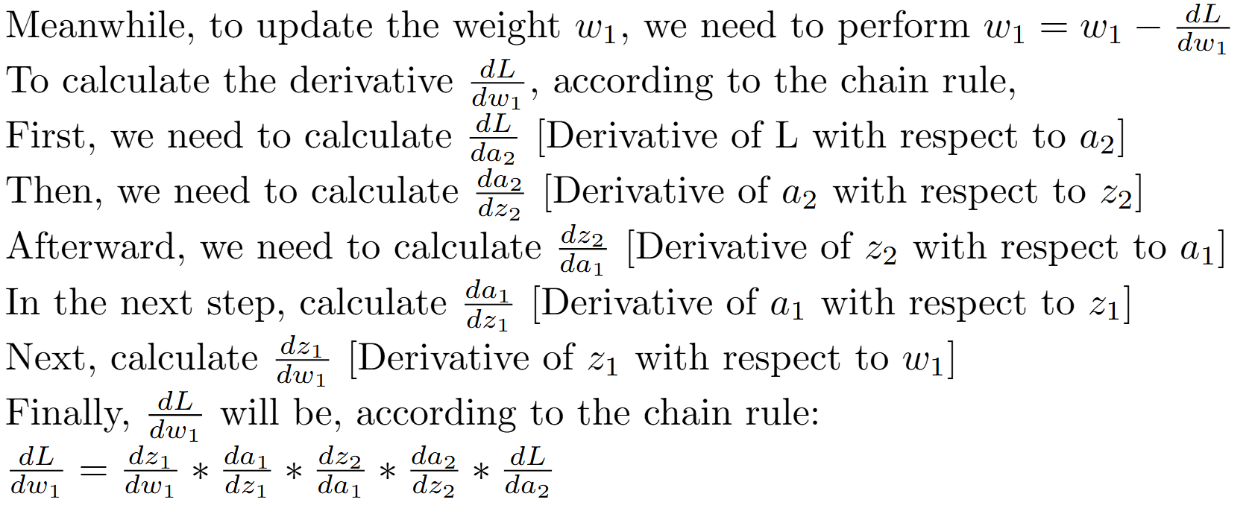

Slide 30

This is a fairly large differentiation and, with increasing layer count, can very quickly go out of hand. But wait…
While calculating the derivative w.r.t. w_{2,} the red-marked portion has already been calculated. We can just get the numerical values and plug them in.
For the gradient of each of the layer, we just need to store the gradient value for the earlier layer and plug them in, making the derivative calculation process much simpler.
In such a case, we are just propagating the gradient back from the later layer, hence the name ‘backpropagation’.

Slide 31
No matter how complex an expression is, it can be broken down into simple arithmetic expressions.
It is possible to easily calculate the derivative of these individual simple expressions, get their values, apply chain rule repeatedly, and plug them in to the earlier operation from the later operation.
This method is known as automatic differentiation and is capable of calculating all the gradients in a single backward swoop.
This is how deep learning libraries are capable of calculating derivatives even in very complex networks.
Some other differentiation alternatives would be symbolic differentiation (can become too complex in a large network) and numerical differentiation (not very accurate).

